Slide 1
Mobile Computing Android Mini Project
Class Scheduler

Slide 2


Subject Teacher | Lab Teacher | App Developer
Dr. Nupur Giri. | Prof. Vinayak Kachare. | Aakash Goplani. D17A – 29.

Slide 3
Objective / Vision
Class time table project main objective is to develop an Android application which can help institutions, schools or colleges faculty members to plan and schedule classes and batches.
Trainer can enter details of the batches and timings of the batches from starting and ending date with the scheduling the class.
Whenever faculty wants to know about class timings he can find them using this application.

Slide 4
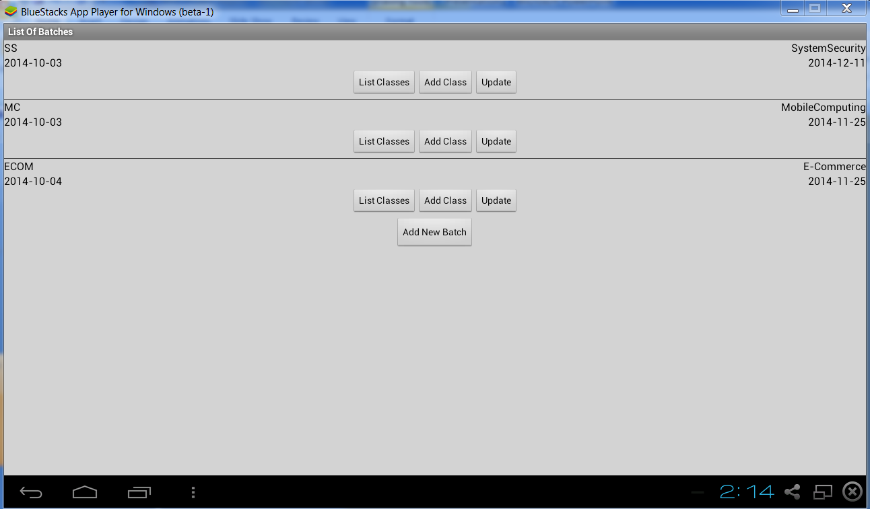
Snapshot

Slide 5
Reviews and Users of the System
In existing system we use software application to know about timings and plan batches and classes.
With this application now we can manage all these details using android app.
This process is more handy and we know information any time.
USERS
Teachers
Lab Assistants.

Slide 6
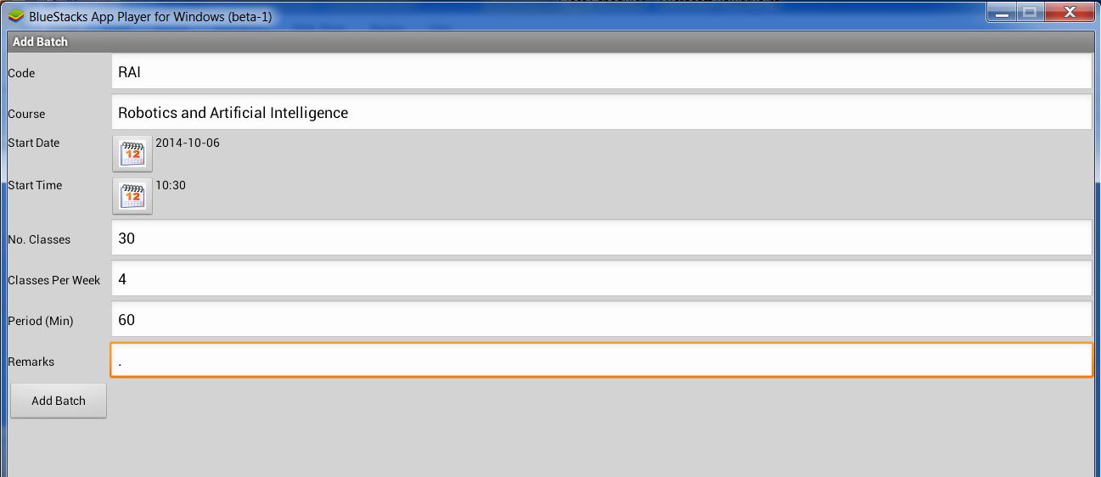
Functional Requirements
Add a new Batch.

Slide 7
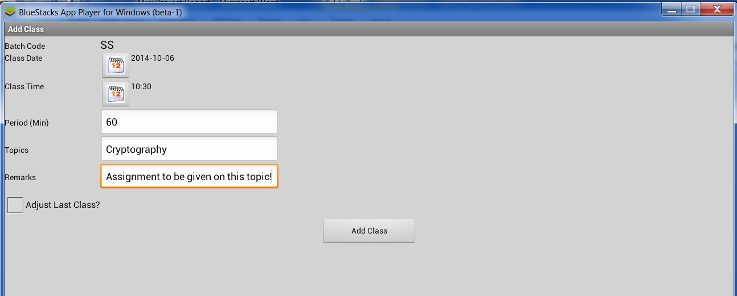
Functional Requirements
Add new Class in a Batch.

Slide 8
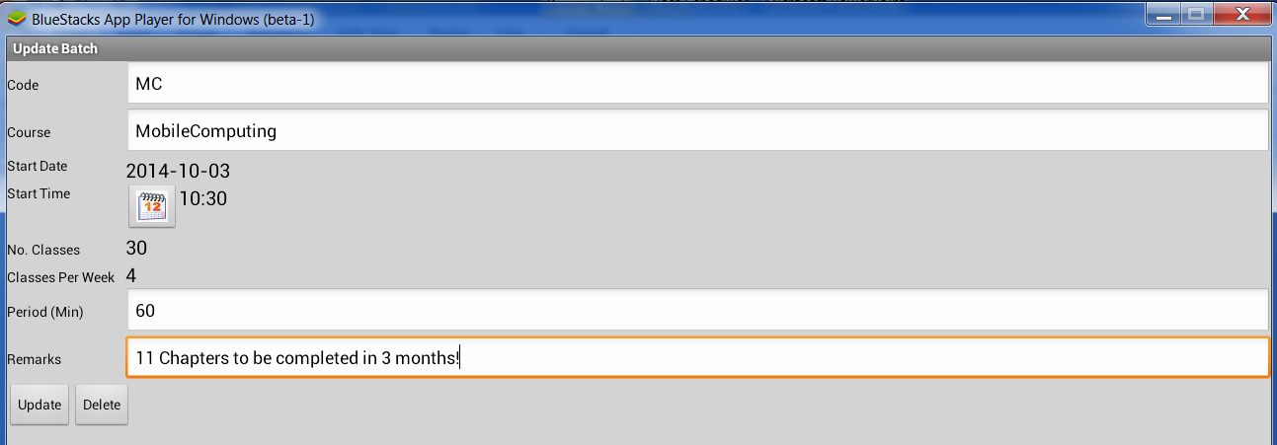
Functional Requirements
Update or Delete an existing batch.

Slide 9
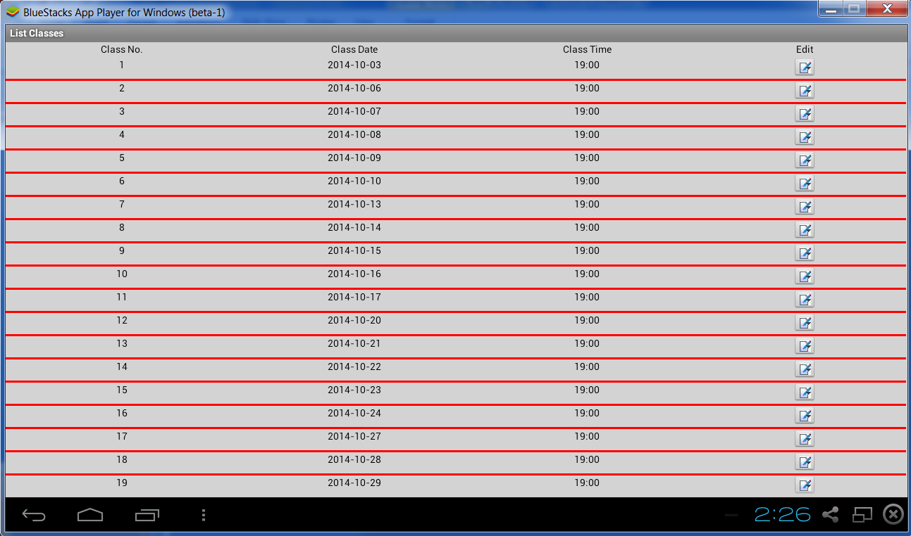
Functional Requirements
List all the batches.

Slide 10
Non- Functional Requirements
Extensibility (adding features and carry forward customization at next major version.)
Usability (Users can easily avail the features of this application.)
Testability (An intensive series of tests can be applied to check if all its functional requirements are met or not.)
Reliable.

Slide 11
Other Important Issues
Professional look and feel.
Easy to navigate throughout the application.
Clear and Simple instructions to guide users.
The application is scalable and the system is tuned for optimized performance at peak time.
The application is easy enough to deploy, highly flexible and easy to maintain.

Slide 12
Technologies and Tools to be used for Application Development
Android
Eclipse
Windows 7

Slide 13
Example Scenario
Teachers maintaining list of batches and classes or portion they have completed till date.
Lab Assistants maintaining time table of each batch.

Slide 14
Thank You!

